Slide 1
Sprint 1 Retro

Slide 2
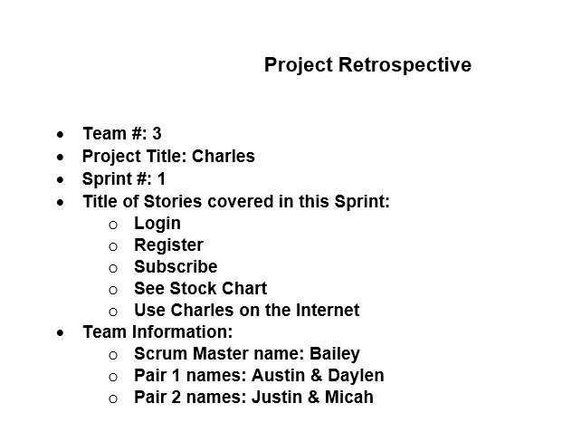

Slide 3
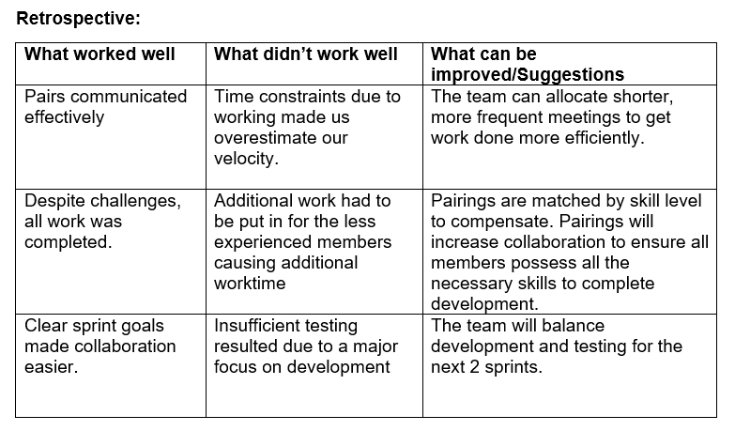

Slide 4
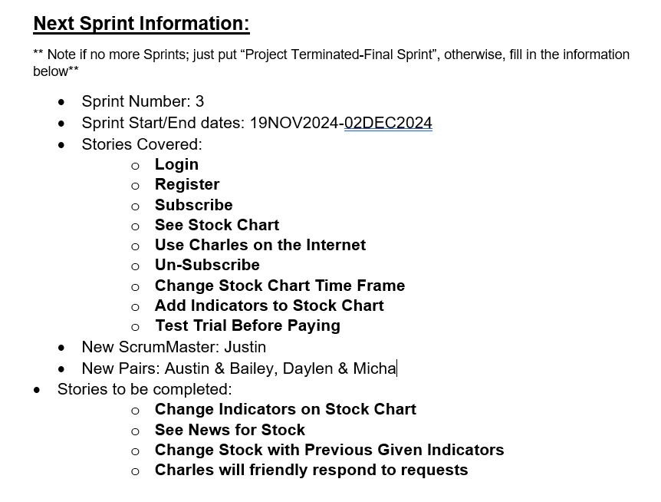

Slide 5
Sprint 2 Retro

Slide 6
Project Retrospective
Team 3
Project Title: Charles
Sprint 2
Title of Stories Covered in Sprint
Un-Subscribe
Change Stock Chart Time Frame
Add Indicators to Stock Chart
Test Trial Before Paying
Team Information:
Scrum Master: Daylen Griffin
Pair 1: Bailey Nguyen & Justin W. Hawthorne
Pair 2: Austin Johnson & Micah Clark

Slide 7
Retrospective
What worked well | What didn’t work well | What can be Improved/Suggestions
Clear sprint goals made collaboration easier. | Time constraints reduced the amount of testing that could be performed. | Balancing development and testing for future development.
Pairs communicated efficiently and effectively to complete each story. Conducted additional practice for daily standup meeting(s). | Additional life responsibilities made it difficult to collaborate in person. | Allocating shorter more frequent meetings to increase communication frequency.
Despite challenges, all work was completed on time. | Lesser experienced developers experienced a larger learning curve versus the veteran team members. | Continuing to pair veteran members with newer developer members to increase knowledge transfer and skill development.

